Slide 1

Windows 2000 System Mechanisms
Computing Department,
Lancaster University, UK

Slide 2
Overview
Goals
  Introduce concept of objects and handles
  Look at trap and interrupt dispatching
  Examine software and hardware interrupt processing

Slide 3
Processes, Objects and Handles

Slide 4
Introduction to Objects (1)
What are objects?
  Single, run-time instance of a statically defined object type
  Object type comprises
    System-defined data type
    Function that operates on instances of the data type
    Set of object attributes
  E.g. process is an instance of the process object type, file is an instance of the file object type, etc.
Objects vs. Data Structures
  Internal structure of an object is hidden!
  Must call object service to read/write data

Slide 5
Introduction to Objects (2)
Objects help accomplish the following tasks:
  Providing human-readable names for resources
  Sharing resources/data among processes
  Protecting resources from unauthorised access
  Reference tracking (to de-allocate unused objects)
Data that needs to be shared, protected, named or visible to user-mode programs is placed in objects
Handles are references to an instance of an object
Object Manager responsible for creating, deleting, protecting and tracking objects

Slide 6
Objects and Handles (1)
Three types of Win32 objects (therefore, handles)
  Win32 “kernel objects” (events, mutexes, files, processes, threads)
    Objects managed by “Object Manager”
    Handle values are private to each process
  Win32 “GDI objects” (pens, brushes, fonts)
    Managed by Win32 subsystem
    Handle values are valid system-wide
  Win32 “User objects” (windows, menus)
    Objects managed by Win32 subsystem
    Handle values are valid system-wide

Slide 7
Objects and Handles (2)
Many Win32 APIs take arguments that are handles to system-defined data structures, or “objects”
  App calls CreateXxx, which creates an object and returns a handle to it
  Apps then uses the handle value in API calls that operate on that object
    Referencing object by handle is faster (avoids name lookup)
Processes can also inherit handles
Object handle is an index into a process-specific handle table

Slide 8
Handles, Pointers and Objects
Process A
System Space
Event Object
handles
Handle Table
HandleCount = 1
ReferenceCount = 1
index
Handle to a kernel object is an index into the process handle table (invalid in other processes)
Handle table entry contains the system-space address of the data structure
Although handle table is per-process, it is actually in system address space (hence protected)
Process B
Handle Table

Slide 9
Handles and Reference Counts
Process A
System Space
Event Object
handles
Handle Table
HandleCount = 2
ReferenceCount = 3
index
Other Structure
Duplicate Handle
Process B
Handle Table
Event Object
HandleCount = 1
ReferenceCount = 1

Slide 10
Handles and Security
Process handle table
  Unique for each process
  In system address space, hence cannot be modified from user mode (therefore, trusted)
Security checks are made when handle table entry is created
  When CreateXxx called
  Handle table entry indicates the “validated” access rights to the object
    Read, Write, Delete

Slide 11

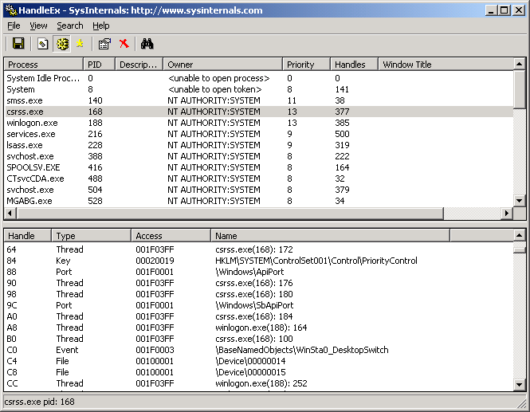
Looking at Open Handles
HandleEx available from www.sysinternals.com

Slide 12
Object Manager
Executive component for managing system-defined “objects”
  Objects are data structures with optional names
  Object manager implements user-mode handles and process handle table
Object manager functionality:
  Provides uniform naming, sharing and protection scheme
    Simplifies C2 security – centralises object protection
  Maintains counts of handles/references to each object
    Object cannot be freed until all handles/references are gone

Slide 13
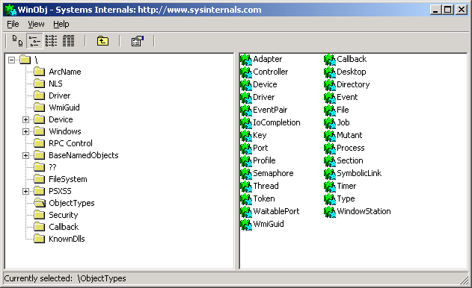
WinObj
WinObj available from www.sysinternals.com

Slide 14
Kernel Mode Programming Environment

Slide 15
Invoking Kernel-Mode Routines
Code is run in kernel mode for one of three reasons:
  Requests from user mode
    Via system service dispatch mechanism
  Interrupts from external devices
    Interrupts are handled in kernel mode
    Win 2000 interrupt dispatcher invokes interrupt service routine (ISR)
  Dedicated kernel-mode threads
    Some threads in the system stay in kernel mode at all times (mostly in the “System” process)

Slide 16
Trap Dispatching
Interrupts and exceptions divert the processor to code outside normal flow of control
Can be detected by hardware or software
Trap
  Mechanism for catching an executing thread
  Transferring control to a fixed location in the OS
Windows 2000
  Processor transfers control to a trap handler “front-end”
    Then transfers control to other functions to field the trap
    E.g device interrupt – transfers control to ISR provided by device driver

Slide 17
Trap Dispatching (2)
Trap Handlers
Interrupt
Interrupt service routines
System service call
System Services
Hardware/Software Exceptions
Exception Dispatcher
Exception Handlers
Virtual Address Exceptions
Virtual memory manger’s pager

Slide 18
Interrupts and Exceptions
Interrupt
  Asynchronous (can occur at any time)
  Generated by I/O devices, processor clocks, timers etc.
Exception
  Synchronous
  Results from execution of a particular instruction
  Examples
    Memory Access Violation, Divide By Zero
Both can be generated by Hardware & Software
  Exceptions: Bus Error, Divide-by-Zero
  Interrupts: I/O Device, Software Interrupts (DPCs)
When interrupt/exception generated
  Processor records enough state to return to the current point and continue execution later

Slide 19
Interrupt Dispatching (1)
Interrupts allow OS to maximise CPU usage
  Thread starting I/O transfer to/from device
    Can continue useful work whilst the device completes the transfer
    Device interrupts processor when it needs service
Mice, Printers, Keyboards, Disk Drives are all typically interrupt driven
Device drivers supports ISRs to service device interrupts
Kernel provides interrupt handling for other types

Slide 20
Interrupt Dispatching (2)
User/kernel mode code
Kernel mode
Interrupt Dispatch Routine
Disable Interrupts
Record machine state to allow resume
Mask equal- and lower-IRQL interrupts
Find and call appropriate ISR
Dismiss interrupt
Restore machine state (include mode and enabled interrupts)
Interrupt Service Routine
Interrupt !
Tell device to stop interrupting
Interrogate device state, start next operation on device
Request a DPC
Return to caller

Slide 21
Interrupt Precedence via IRQLs
Windows 2000 has its own interrupt priority scheme
  IRQL = Interrupt Request Level (0 to 31)
Different interrupt sources have different IRQLs (not equal to IRQs!)
Interrupts serviced in priority order
  High priority interrupt pre-empts lower-priority interrupt
Servicing an interrupt raises processor IRQL to that interrupt’s IRQL
  Masks off subsequent interrupts at equal/lower IRQLs
31
High
30
Power Fail
29
Inter-processor Interrupt
Hardware Interrupts
28
Clock
Device n
...
Device 1
2
Dispatch/DPC
Software Interrupts
1
APC
0
Passive
Normal Thread Execution

Slide 22
Software Interrupts
Windows 2000 can also generate interrupts itself!
Whilst code is running at elevated IRQL, nothing else can execute on the same CPU at that or any lower IRQL
  Potentially can make the system less responsive to time-critical events
  Windows 2000 avoids this situation by executing as much code as it can at the lowest possible IRQL
Deferred Procedure Calls (DPCs)
  Used to defer processing from higher (device) interrupt level to a lower (dispatch) level
  DPC used to schedule non-immediate code, e.g.
    I/O drivers queue DPCs to complete I/O
  DPCs are serviced once IRQL reaches dispatch level

Slide 23
Hardware Interrupt Processing (x86)
Device raises interrupt on interrupt controller
Interrupt controller in turn interrupts CPU on single line
CPU queries interrupt controller for IRQ (interrupt request)
Assume current IRQL is < (IRQ mapped to appropriate IRQL)
Trap Handler called
Trap Handler saves context (including current IRQL), disables interrupts, enters interrupt dispatcher

Slide 24
Hardware Interrupt Processing (x86)
Interrupt Dispatcher raises current IRQL to new IRQL and enables interrupts
IRQ mapped to interrupt number in Interrupt Dispatch Table (IDT)
  Interrupt Dispatch (IDT) used to transfer control to the appropriate interrupt dispatch routine
  IDT lists pointers to kernel routines for each interrupt
Appropriate interrupt routine called
On exit from interrupt routine, IRQL is returned to the original value prior to the interrupt and context is reloaded

